Slide 1
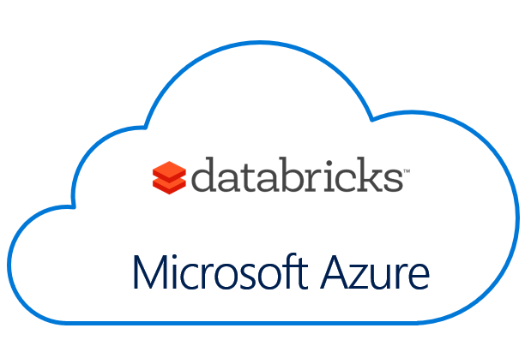
Azure Databricks A Brief Introduction Bryan Cafferky Data Solutions Enabler
https://github.com/bcafferky/shared

Slide 2




About Bryan Cafferky…
Microsoft Data and AI Solutions Enabler for Healthcare
Decades of IT Experience
Past Microsoft Data Platform MVP and Cloud and Data Center MVP
Author of Pro PowerShell for Database Developers
Experienced in health care, insurance, banking, and ecommerce
Founded and lead PASS Chapter The RI Microsoft BI User Group and The Boston Data Science Group
https://www.linkedin.com/in/bryancafferky
Subscribe to my YouTube Channel

Slide 3
Where Are We Heading?
Azure Data and Machine Learning Services Overview
Big Data and Machine Learning at Scale
Azure Databricks Overview
Wrapping Up

Slide 4
Why Azure?
Enablement and Ease of Use
Integration
Fluid Scaling
Enterprise Solutions
Secure
Support

Slide 5

Why So Many Options?

Slide 6

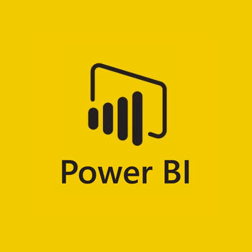
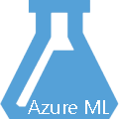
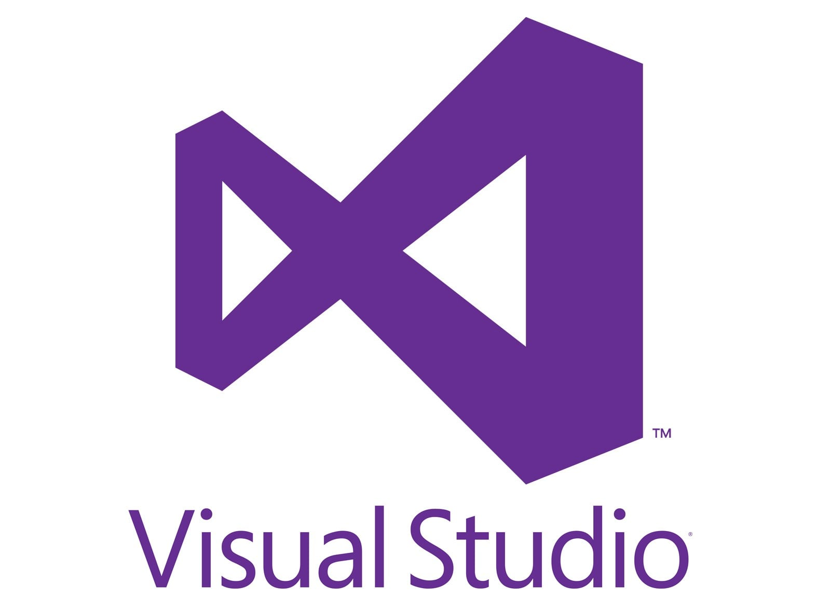
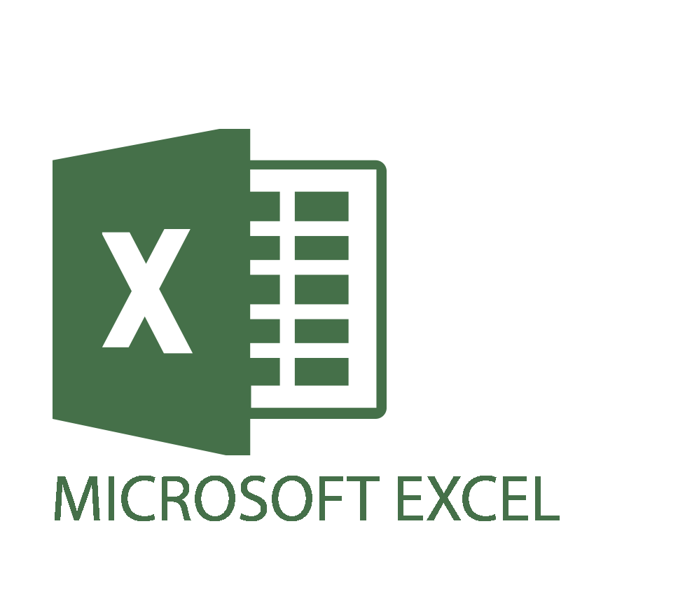



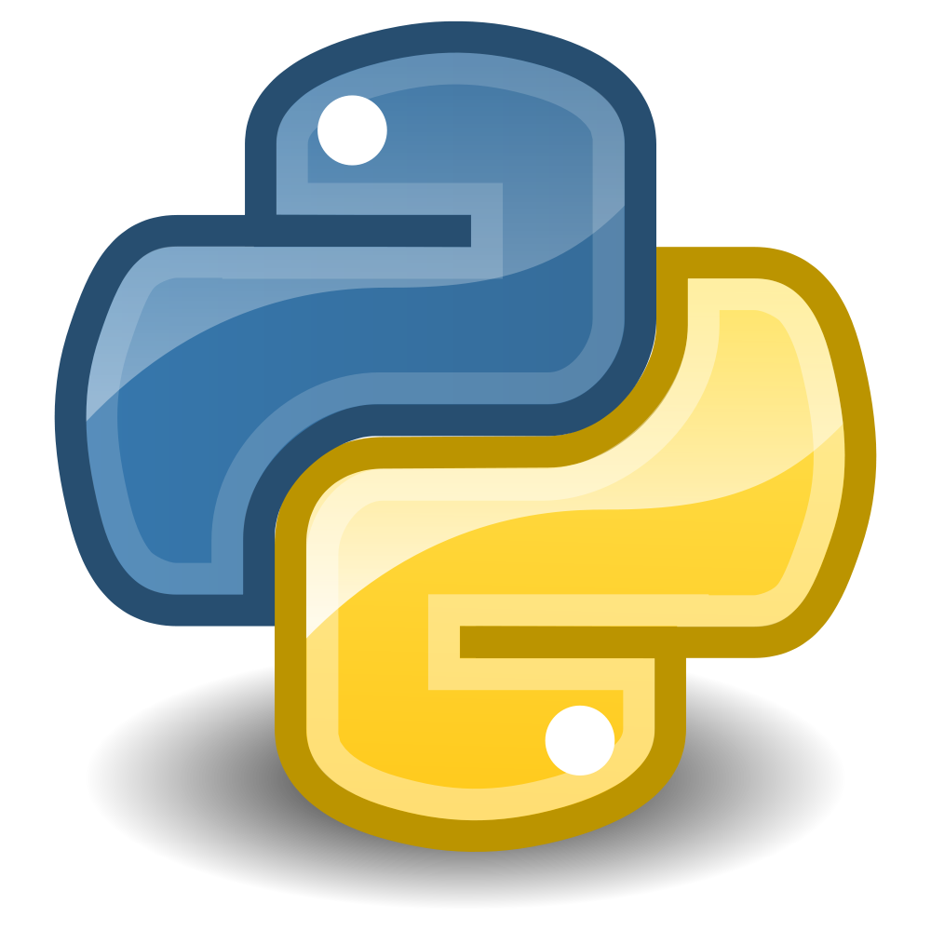


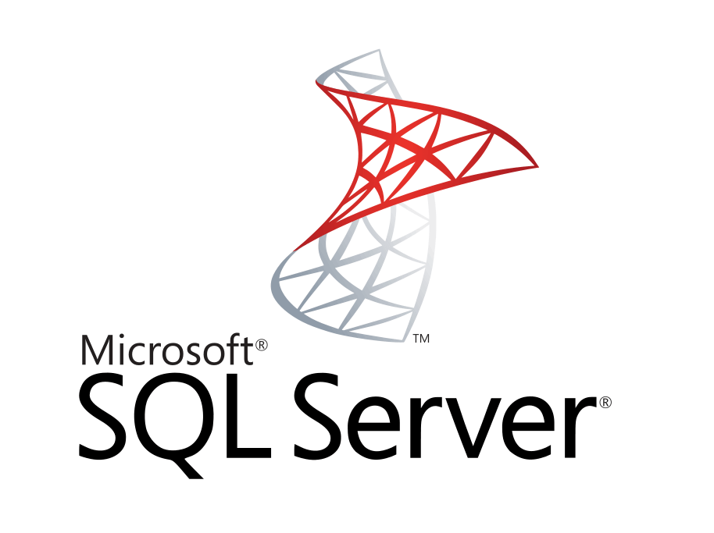

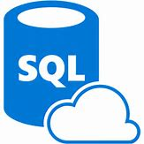
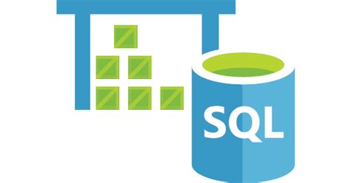



Data Analysis Platform
Client Tools
Streaming
Azure Data Factory
Data Ingestion
Azure Cognitive
Services
On-Prem
Analysis Services
Managed Instance/
SQL DB
SQL Data Warehouse
Cosmos DB
HDInsight
Databricks
Massively Parallel Processing
Cloudera via Marketplace
PostgreSQL and MySQL Offered as Azure Services (in preview).
Scale

Slide 7




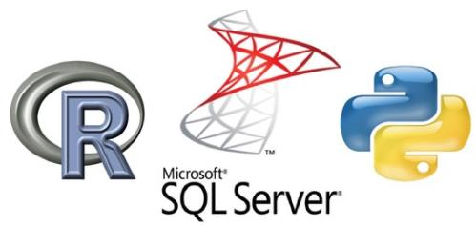

Azure Supported Machine Learning Approaches
Custom Build Your Own
Pre Built
Scalable
Scalable
Non Scalable
Poor Scalability
Language Dependent
Model Performance Varies
Examples:
Very High Scalability
General API
Examples:
High Scalability
Support
Examples:
Services
Pre Trained
Easy to Use
Fitted to a Purpose
Examples:
Cognitive Services
Open Source
Commercial

Slide 8
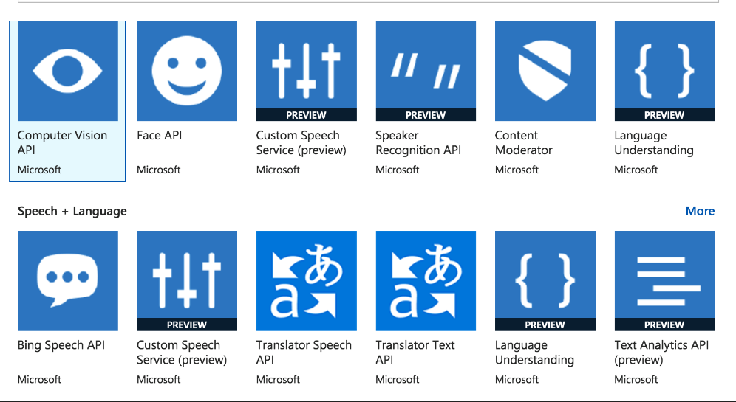
Cognitive Services

Slide 9


Machine Learning Solutions
Partner Solutions
Pre Built Solutions
Customize to Your Needs
Examples

Slide 10
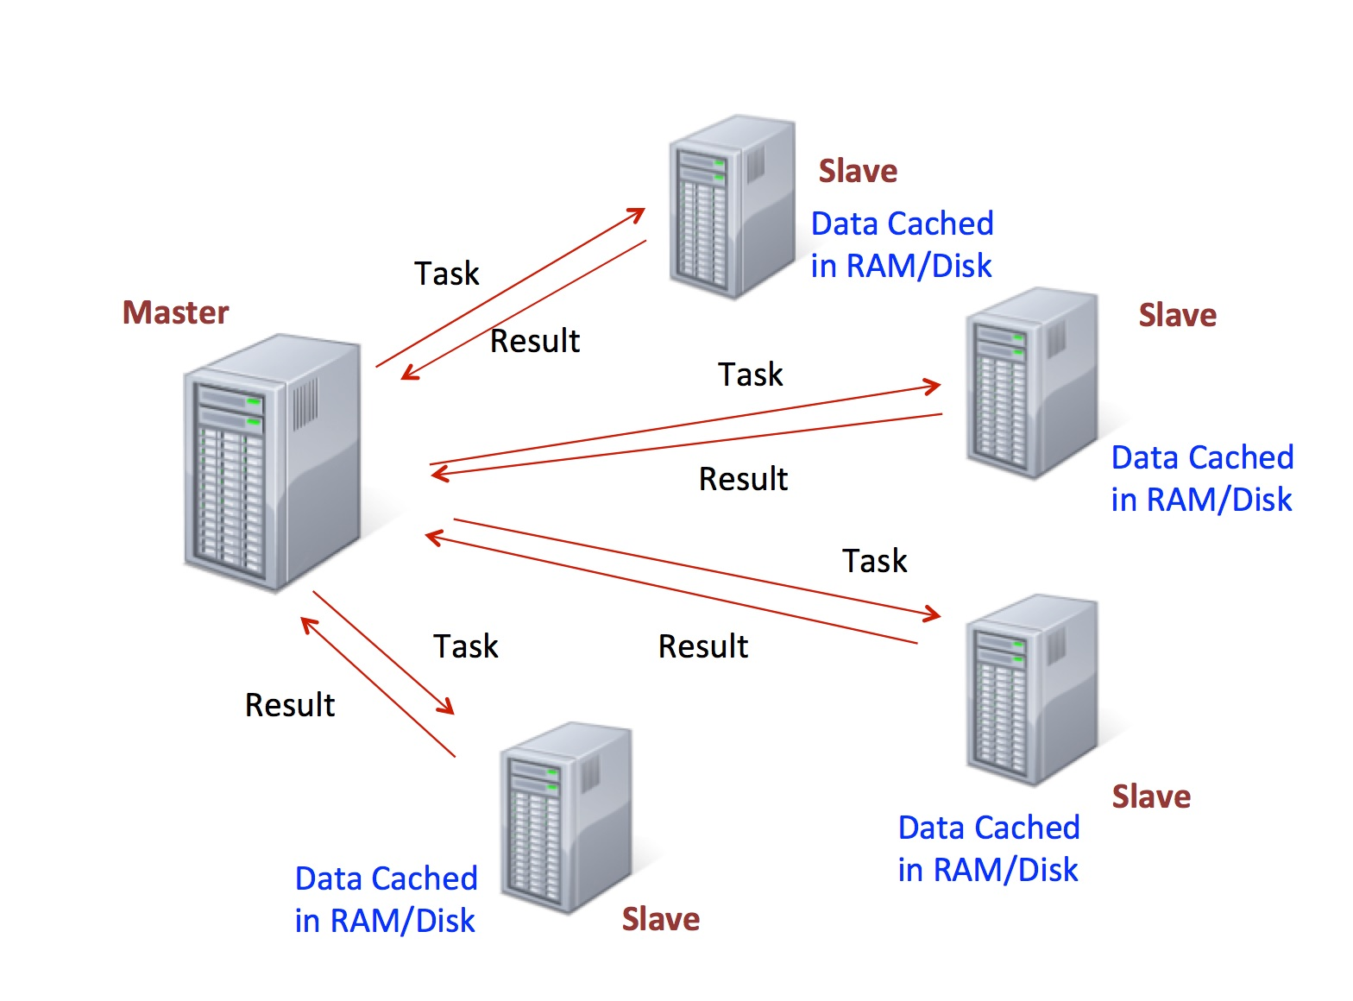
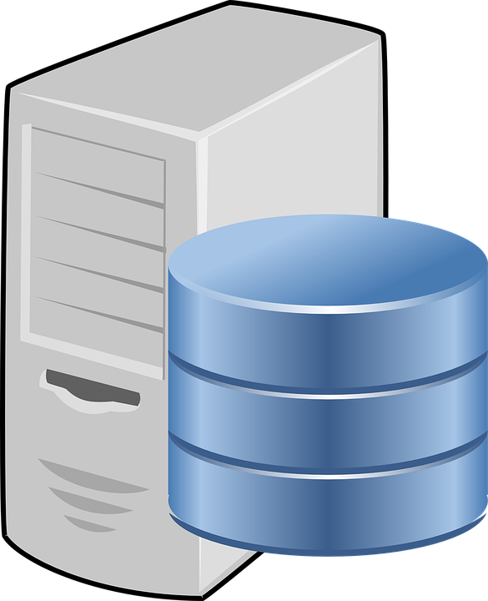

Scale Up vs. Scale Out
Moving Up the Scale
Max = Petabytes+
Max = Terabytes
Max = Megabytes
Large
HDInsight, Databricks, DW, CosmosDB
Medium
SQL Server/ML Server
Small
Open Source
Scale Up
Scale Out

Slide 11
Machine Learning Services

Slide 12
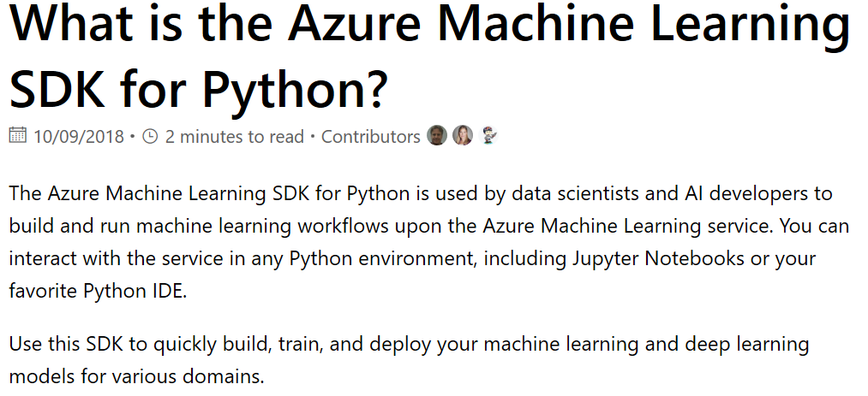
Using Python and Azure ML Services
https://docs.microsoft.com/en-us/python/api/overview/azure/ml/intro?view=azure-ml-py

Slide 13
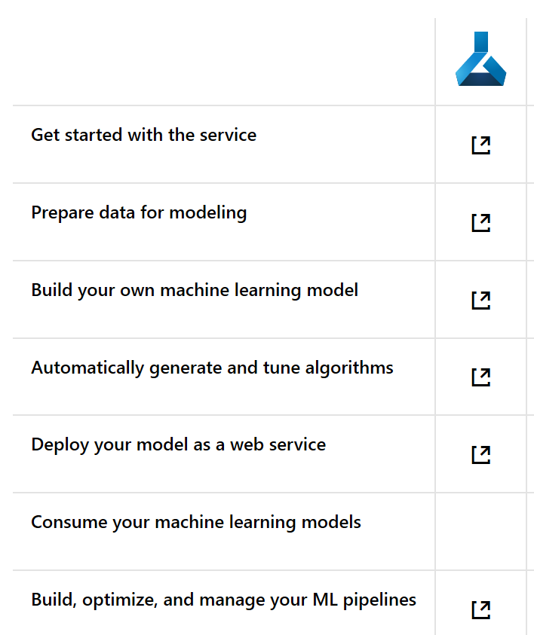
Azure ML Services
https://docs.microsoft.com/en-us/azure/machine-learning/

Slide 14
What was the Python Programming Language Named After?
Monty Python’s Flying Circus

Slide 15
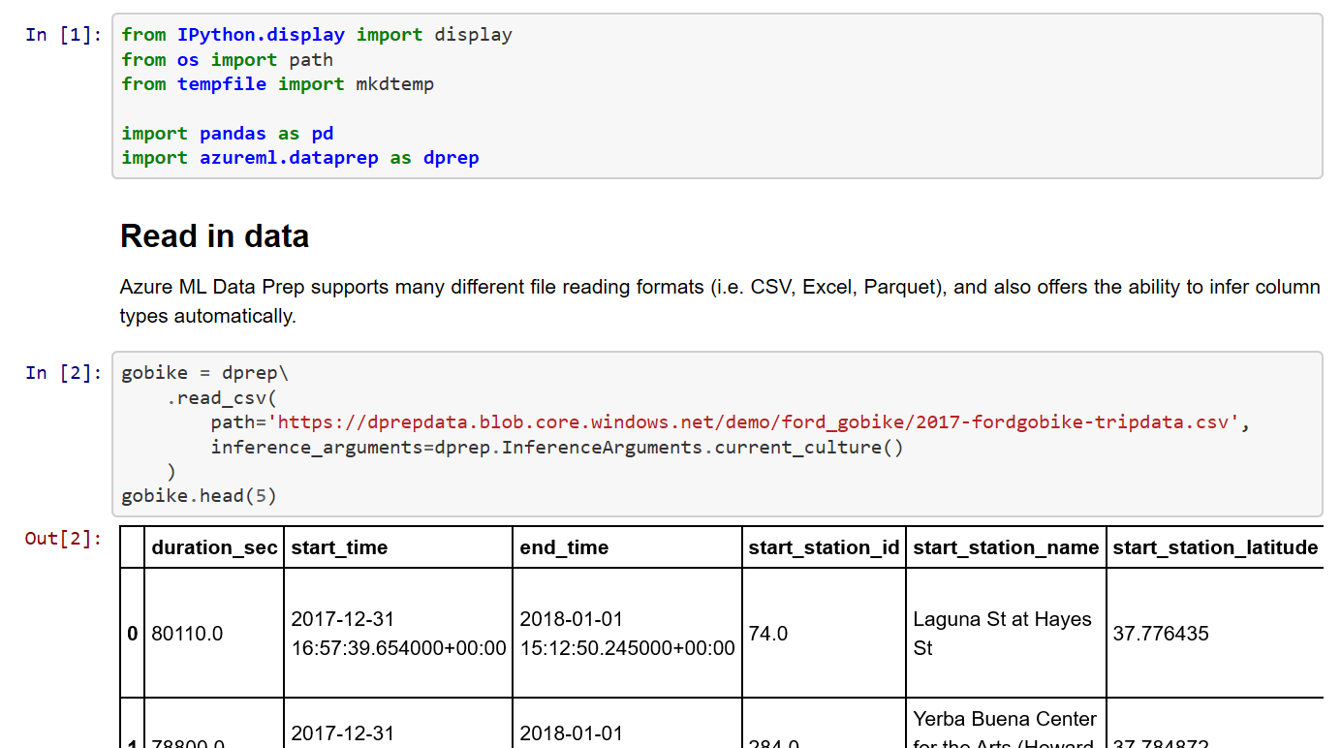
Azure ML Services from a Jupyter Notebook
https://github.com/Microsoft/AMLDataPrepDocs/blob/master/Scenarios/GettingStarted/getting-started.ipynb

Slide 16
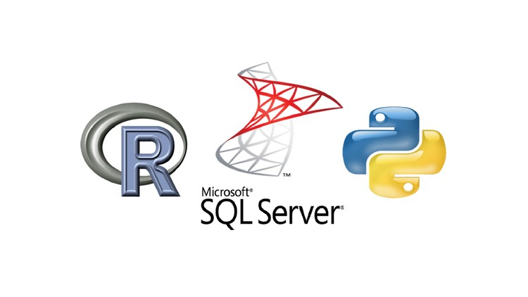
SQL Server/Machine Learning Server Integration

Slide 17
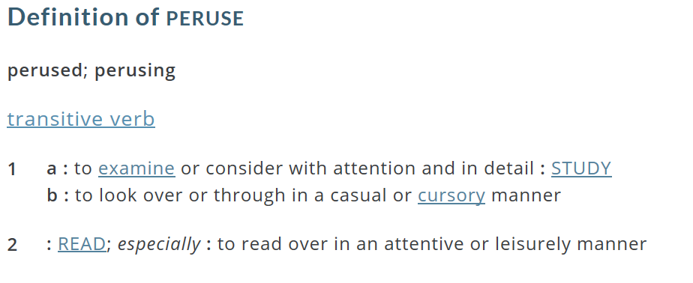
Clarifying Bad Terms
Same Word
Opposite Meanings

Slide 18
Clarifying Bad Terms
Analytics
Visualizations and/or
Machine Learning
Challenging
Big Data
Non traditional:
Movies, Images, massive, streaming
Data Lake
No such thing. Just Blob storage.
Machine
Learning
Includes AI, Deep Learning, Predictive Modeling

Slide 19


Scale Up vs. Scale Out
Scale Up
Scale Out

Slide 20

Scale Up vs. Scale Out
Scale Out

Slide 21
Scale Up vs. Scale Out
Moving Up the Scale
Max = Petabytes+
Max = Terabytes
Max = Megabytes
Large
HDInsight, Databricks, DW, CosmosDB
Medium
SQL Server/ML Server
Small
Open Source
Scale Up
Scale Out

Slide 22

My Kitchen Drawer

Slide 23
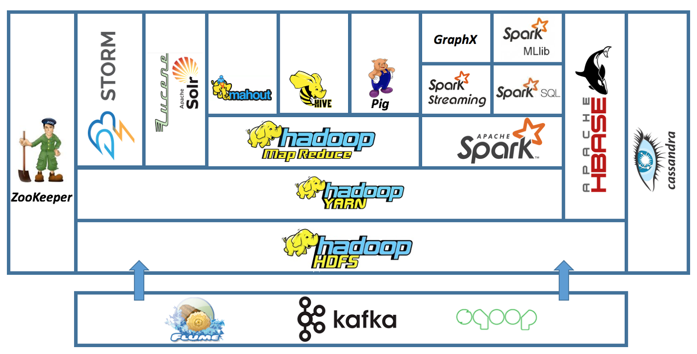
The Apache Hadoop Ecosystem
Databricks
HDInsight
In Memory MPP
NoSQL
Storage
Streaming
Distributed
System
Coordination
Full Text
Search
ETL
Machine Learning
SQL
Real Time
H
a
d
o
o
p
B
A
T
C
H
Queuing Service
Move Data to/From SQL Databases
Streaming

Slide 24
The Two Hadoops
Big Hadoop is the Apache Project
Little Hadoop (Map/Reduce) writes to Disk
Spark Works In Memory

Slide 25
Apache Spark
An unified, open source, parallel, data processing framework for Big Data Analytics
Spark SQL
Interactive Queries
Spark MLlib
Machine Learning
Spark Streaming
Stream processing
GraphX
Graph Computation
Spark Unifies:
Batch Processing
Interactive SQL
Real-time processing
Machine Learning
Deep Learning
Graph Processing
Spark Core Engine
Yarn
Mesos
Standalone Scheduler
Spark MLlib
Machine Learning
Spark Structured Streaming
Stream processing

Slide 26
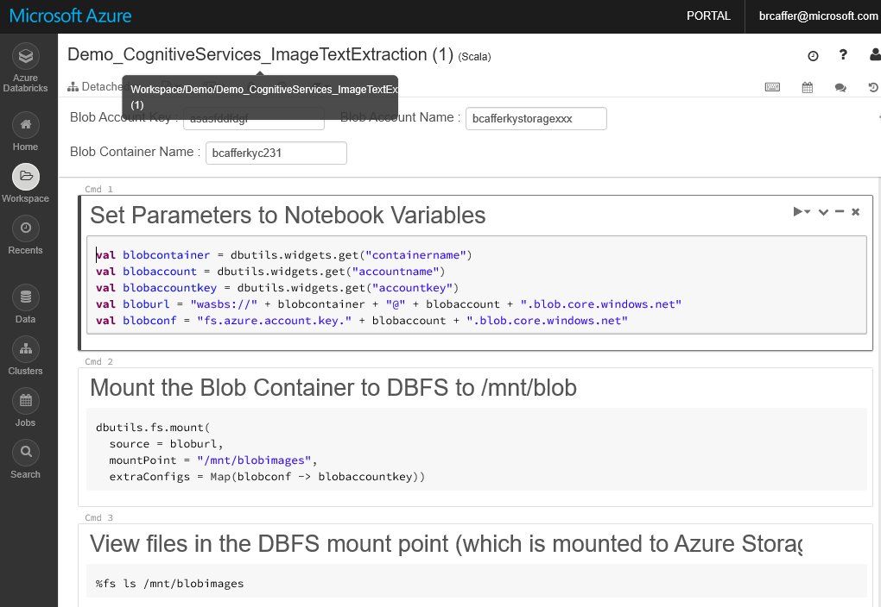
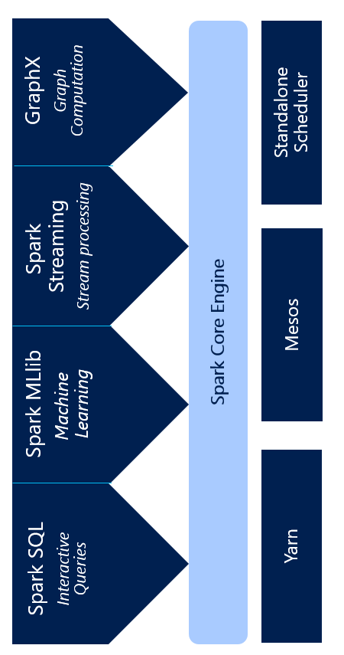
It all runs on Spark
Azure Databricks
Notebooks
Integrated Blob File System
Secure Collaboration
Click Cluster Creation
Job Scheduler
Language Extensions
Spark Optimizations

Slide 27


HDInsight vs. Azure Databricks
HDInsight
Azure Databricks

Slide 28




Azure
Easy
Cluster Creation
Scheduling
Big Data
Notebooks
Security
Collaboration

Slide 29
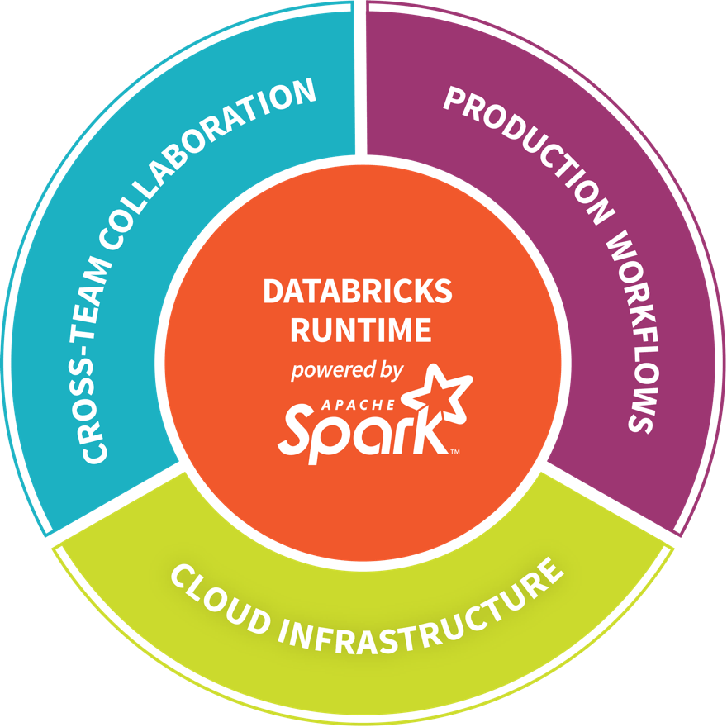
Databricks - Company Overview
Founded in late 2013
By the creators of Apache Spark, original team from UC Berkeley AMPLab
Largest code contributor code to Apache Spark
Level 2/3 support partnership with
Hortonworks
MapR
DataStax
Provides certifications such as Databricks Certified Application, Databricks Certified Distribution and Databricks Certified Developer
Main Product: The Unified Analytics Platform
In Oct 2017, introduced Databricks Delta (currently in private preview).

Slide 30

Azure Databricks
Azure Databricks is a first party service on Azure.
Unlike with other clouds, it is not an Azure Marketplace or a 3rd party hosted service.
Azure Databricks is integrated seamlessly with Azure services:
Azure Portal: Service an be launched directly from Azure Portal
Azure Storage Services: Directly access data in Azure Blob Storage and Azure Data Lake Store
Azure Active Directory: For user authentication, eliminating the need to maintain two separate sets of uses in Databricks and Azure.
Azure SQL DW and Azure Cosmos DB: Enables you to combine structured and unstructured data for analytics
Apache Kafka for HDInsight: Enables you to use Kafka as a streaming data source or sink
Azure Billing: You get a single bill from Azure
Azure Power BI: For rich data visualization
Eliminates need to create a separate account with Databricks.
Microsoft Azure

Slide 31

Why Spark?
Open-source data processing engine built around speed, ease of use, and sophisticated analytics
In memory engine that is up to 100 times faster than Hadoop
Largest open-source data project with 1000+ contributors
Highly extensible with support for Scala, Java and Python alongside Spark SQL, GraphX, Streaming and Machine Learning Library (Mllib)
Notes:
When it comes to ease of use, Spark again happens to be a lot better than Hadoop. Spark has APIs for several languages such as Scala, Java and Python, besides having the likes of Spark SQL. It is relatively simple to write user-defined functions. It also happens to boast an interactive mode for running commands. Hadoop, on the other hand, is written in Java and has earned the reputation of being pretty difficult to program, although it does have tools that assist in the process. (To learn more about Spark, see How Apache Spark Helps Rapid Application Development.)
In-Memory Technology
One of the unique aspects of Apache Spark is its unique "in-memory" technology that allows it to be an extremely good data processing system. In this technology, Spark loads all of the data to the internal memory of the system and then unloads it on the disk later. This way, a user can save a part of the processed data on the internal memory and leave the remaining on the disk.
Spark also has an innate ability to load necessary information to its core with the help of its machine learningalgorithms. This allows it to be extremely fast.
Spark’s Core
Spark’s core manages several important functions like setting tasks and interactions as well as producing input/output operations. It can be said to be an RDD, or resilient distributed dataset. Basically, this happens to be a mix of data that is spread across several machines connected via a network. The transformation of this data is created by a four-step method, comprised of mapping the data, sorting it, reducing it and then finally, joining the data.
Following this step is the release of the RDD, which is done with support from an API. This API is a union of three languages: Scala, Java and Python.
Spark’s SQL
Apache Spark’s SQL has a relatively new data management solution called SchemaRDD. This allows the arrangement of data into many levels and can also query data via a specific language.
Graphx Service
Apache Spark comes with the ability to process graphs or even information that is graphical in nature, thus enabling the easy analysis with a lot of precision.
Streaming
This is a prime part of Spark that allows it to stream large chunks of data with help from the core. It does so by breaking the large data into smaller packets and then transforming them, thereby accelerating the creation of the RDD.
MLib – Machine Learning Library
Apache Spark has the MLib, which is a framework meant for structured machine learning. It is also predominantly faster in implementation than Hadoop. MLib is also capable of solving several problems, such as statistical reading, data sampling and premise testing, to name a few.

Slide 32



Azure Databricks
Azure Databricks
Collaborative Workspace
IoT / streaming data
Machine learning models
DATA ENGINEER
DATA SCIENTIST
BUSINESS ANALYST
Deploy Production Jobs & Workflows
Cloud storage
BI tools
MULTI-STAGE PIPELINES
JOB SCHEDULER
NOTIFICATION & LOGS
Data warehouses
Optimized Databricks Runtime Engine
Data exports
Hadoop storage
DATABRICKS I/O
APACHE SPARK
SERVERLESS
Rest APIs
Data warehouses
Enhance Productivity
Build on secure & trusted cloud
Scale without limits
Notes:
Databricks, founded by the team that created Apache Spark – unified analytics platform that accelerates innovation by unifying data science, engineering & business.
75% of the code committed to Apache Spark comes from Databricks
Unified Runtime
Create clusters in seconds, dynamically scale them up and down.
They’ve made enhancements to Spark engine to make it 10x faster than open source Spark
Serverless- Auto-configured multi-user cluster, Reliable sharing with fault isolation
Unified Collaboration
Overall – a simple & collaborative environment that enables your entire team to use Spark & interact with your data simultaneously
DE – Improve ETL performance, zero management clusters. Execute production code from within notebooks
DS - For data scientists, easy data exploration in notebooks
Business SME – interactive dashboards empower teams to create dynamic reports
Enterprise Security
Encryption
Fine grained Role-based access control (files, clusters, code, application, dashboard)
Compliance
Rest APIs
DE – DBIO, SPARK, API’s , JOBS
DS – Spark and Serverless, Interactive Data Science
Data Products - Everything
Creators of Spark
Training People
Number of Customers
Ingest
Workflow
Schedule / Run / Monitor
Execute
Troubleshoot
Debug
Production Jobs
---------
Ingest, ETL, Scheduling, Monitoring

Slide 33
General Spark Cluster Architecture
Driver Program SparkContext
‘Driver’ runs the user’s ‘main’ function and executes the various parallel operations on the worker nodes.
The results of the operations are collected by the driver
The worker nodes read and write data from/to Data Sources including HDFS.
Worker node also cache transformed data in memory as RDDs (Resilient Data Sets).
Worker nodes and the Driver Node execute as VMs in public clouds (AWS, Google and Azure).
Cluster Manager
Worker Node
Worker Node
Worker Node
Cache
Cache
Cache
Task
Task
Task
Data Sources (HDFS, SQL, NoSQL, …)

Slide 34
Demonstration
binu_diabetes_demo

Slide 35





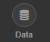
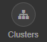
Secure Collaboration
Azure Databricks enables secure collaboration between colleagues
With Azure Databricks colleagues can securely share key artifacts such as Clusters, Notebooks, Jobs and Workspaces
Secure collaboration is enabled through a combination of:
Fine grained permissions: Defines who can do what on which artifacts (access control)
AAD-based authentication: Ensures that users are actually who they claim to be
Fine Grained Permissions
AAD-based User Authentication

Slide 36


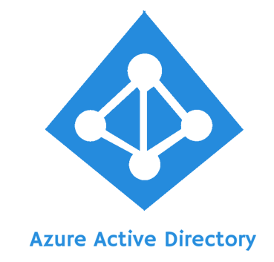
Azure Databricks Integration with AAD
Azure Databricks is integrated with AAD—so Azure Databricks users are just regular AAD users
There is no need to define users—and their access control—separately in Databricks.
AAD users can be used directly in Azure Databricks for all user-based access control (Clusters, Jobs, Notebooks etc.).
Databricks has delegated user authentication to AAD enabling single-sign on (SSO) and unified authentication.
Notebooks, and their outputs, are stored in the Databricks account. However, AAD-based access-control ensures that only authorized users can access them.
Access
Control
Authentication
Azure Databricks

Slide 37
Databricks Access Control
Access control can be defined at the user level via the Admin Console
Access Control can be defined for Workspaces, Clusters, Jobs and REST APIs
Workspace Access Control | Defines who can who can view, edit, and run notebooks in their workspace
Cluster Access Control | Allows users to who can attach to, restart, and manage (resize/delete) clusters. Allows Admins to specify which users have permissions to create clusters
Jobs Access Control | Allows owners of a job to control who can view job results or manage runs of a job (run now/cancel)
REST API Tokens | Allows users to use personal access tokens instead of passwords to access the Databricks REST API
Databricks Access
Control

Slide 38




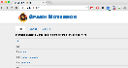
Azure Databricks Core ARTIFACTS
Clusters
Libraries
Workspaces
Azure Databricks
Jobs
Notebooks

Slide 39



Azure Databricks key audiences & benefits
Data scientist
Data engineer
CDO, VP of analytics
Integrated workspace
Easy data exploration
Collaborative experience
Interactive dashboards
Faster insights
Best Spark & serverless
Databricks managed Spark
Improved ETL performance
Zero management clusters, serverless
Easy to schedule jobs
Automated workflows
Enhanced monitoring & troubleshooting
Automated alerts & easy access to logs
Zero Management Spark
Cluster democratization (serverless)
Fast, collaborative analytics platform accelerating time to market
No dev-ops required
Enterprise grade security
Encryption
End-to-end auditing
Role-based control
Compliance
Unified analytics platform
Provided by Microsoft and Databricks under NDA

Slide 40
Advanced Analytics on Big Data
Ingest
Store
Prep & Train
Model & Serve
Intelligence
Logs, files and media (unstructured)
Data factory
Azure storage
Azure Databricks
(Spark Mllib, SparkR, SparklyR)
Azure Cosmos DB
Web & mobile apps
Business / custom apps
(Structured)
Polybase
Data factory
Azure SQL Data Warehouse
Analytical dashboards

Slide 41
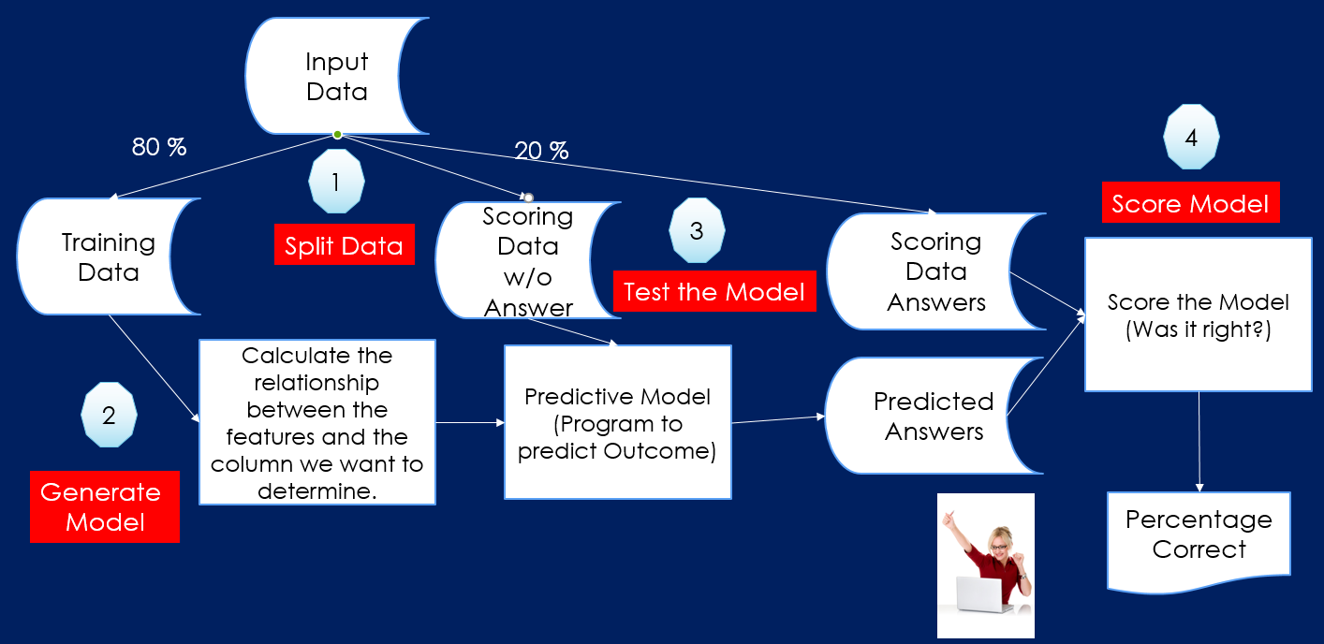
Steps to Predictive Modeling

Slide 42
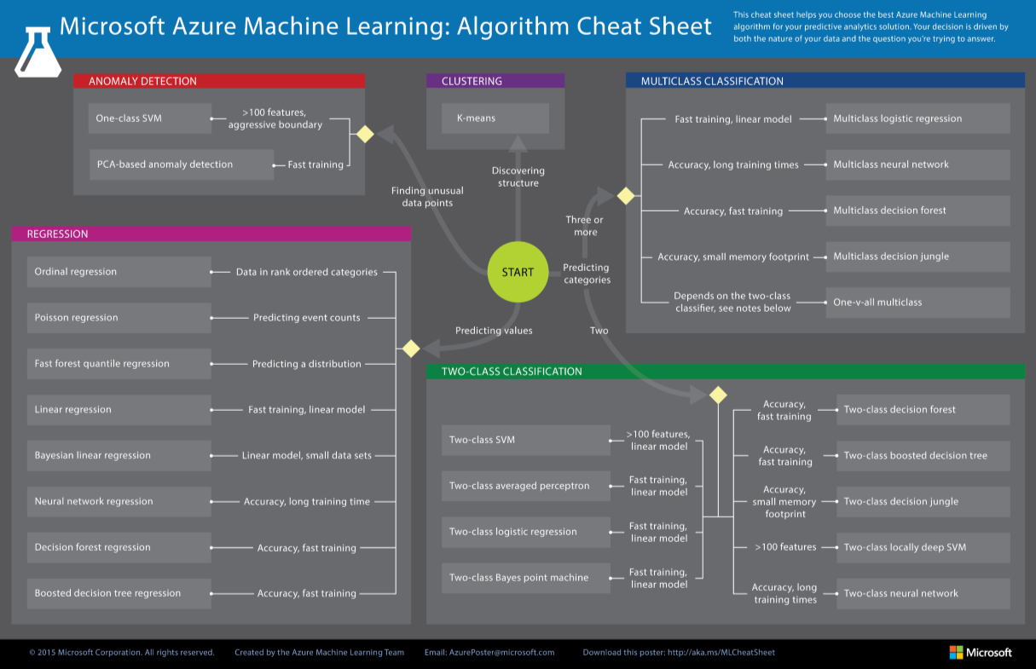
Which Model Do I Choose?
https://docs.microsoft.com/en-us/azure/machine-learning/studio/algorithm-cheat-sheet

Slide 43
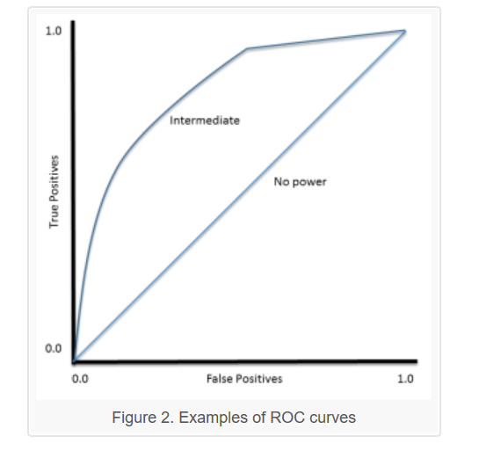
Evaluating Models
Disclaimer: This slide contains non verified non Microsoft Sourced Information and is intended for general concepts. Verify all the information before using.
https://machinelearningmastery.com/assessing-comparing-classifier-performance-roc-curves-2/

Slide 44
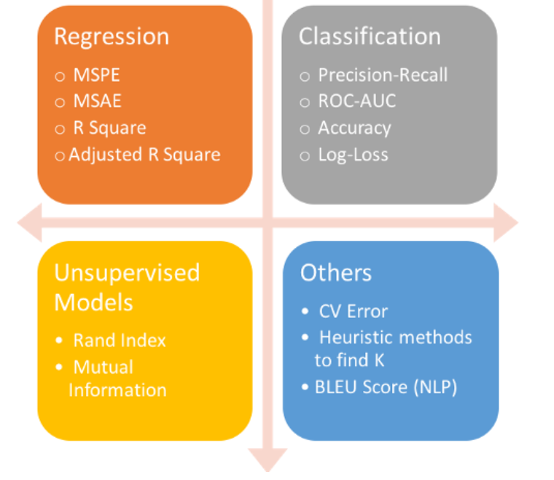
Evaluating Models
Disclaimer: This slide contains non verified non Microsoft Sourced Information and is intended for general concepts. Verify all the information before using.
https://www.kdnuggets.com/2018/04/right-metric-evaluating-machine-learning-models-1.html

Slide 45
Data Analysis Platform
Client Tools
Streaming
Azure Data Factory
Data Ingestion
Azure Cognitive
Services
On-Prem
Analysis Services
Managed Instance/
SQL DB
SQL Data Warehouse
Cosmos DB
HDInsight
Databricks
Massively Parallel Processing
Cloudera via Marketplace
PostgreSQL and MySQL Offered as Azure Services (in preview).
Scale

Slide 46
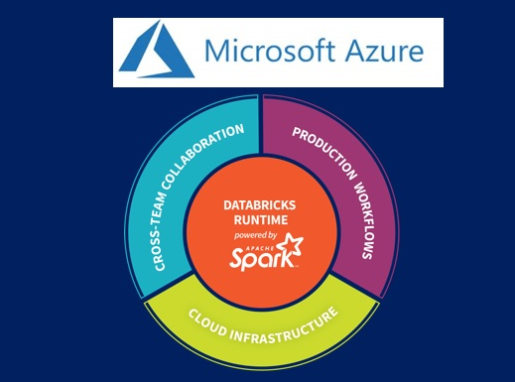
Wrapping Up

